Slide 1
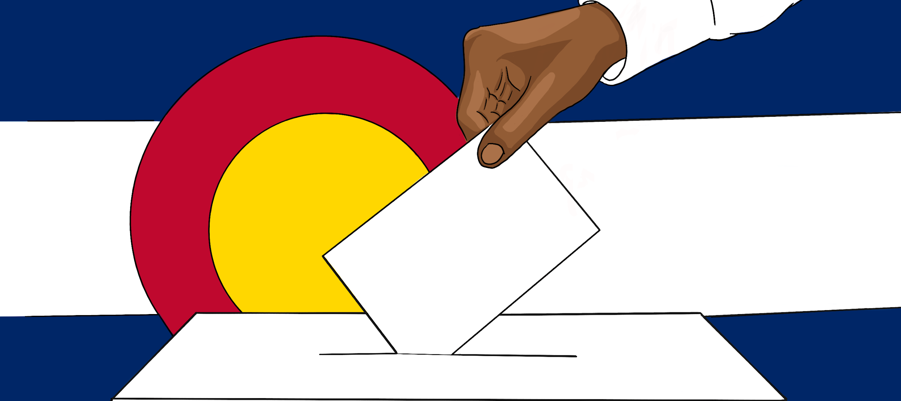
Location! Location!
Where current polling places are, and where they should be.
Michael Burgher//Makayla Cowles//Drew Horton Data to Policy 2020

Slide 2
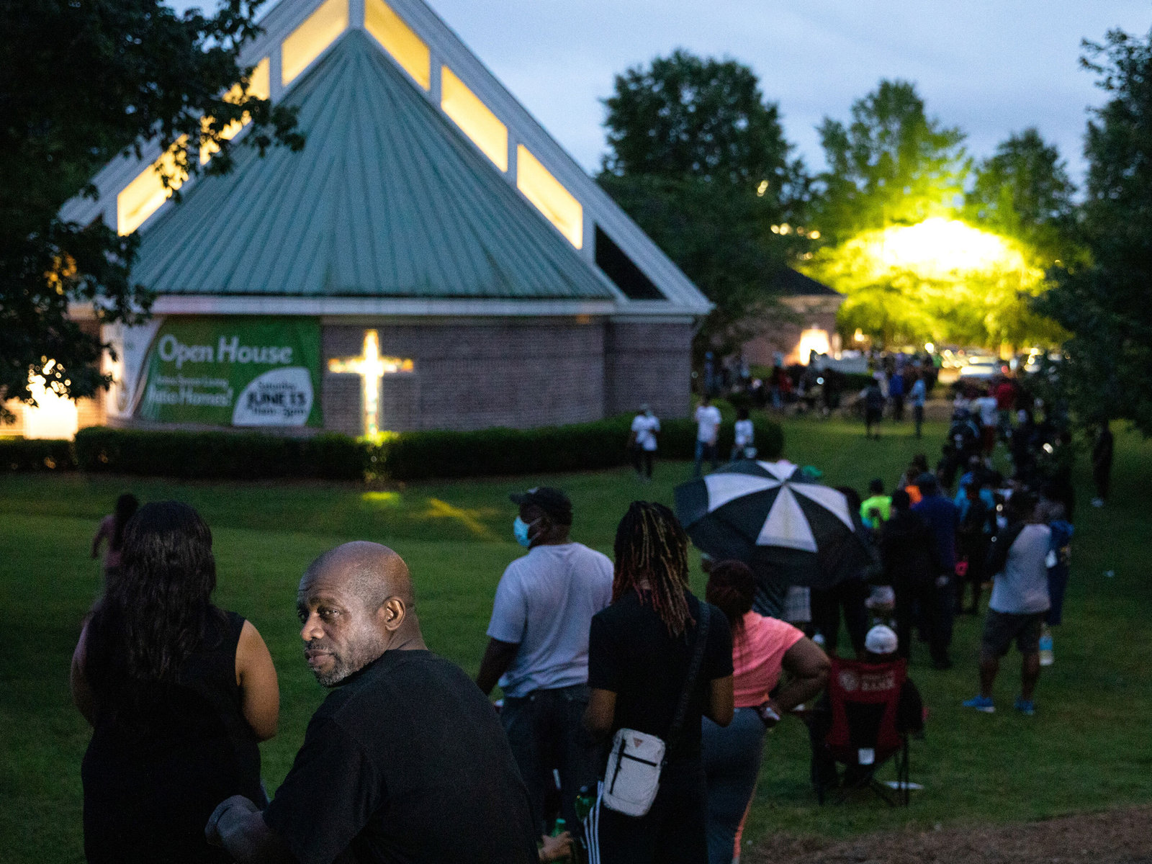
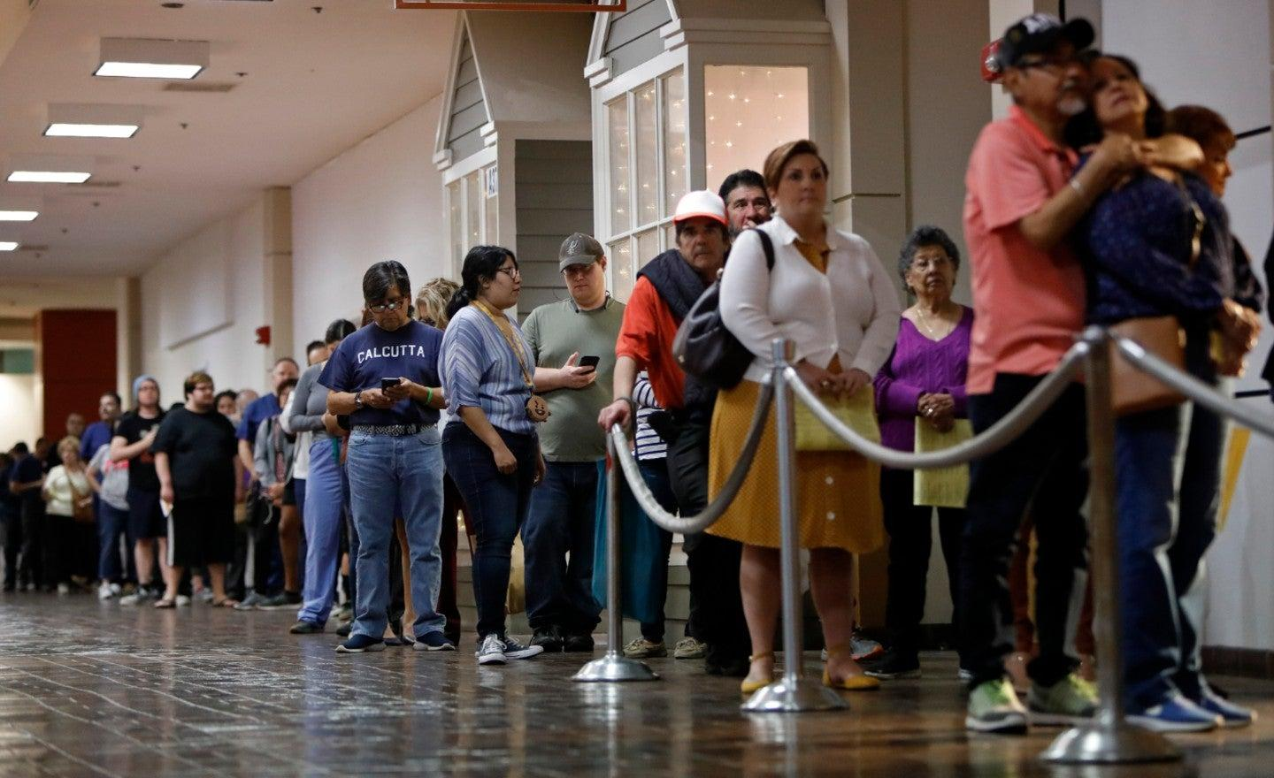
Motivation (Quick Recap!)
Voting is important, and every eligible voter should have EASY and CONVENIENT access to voting
Shelby County v. Holden, section 4(b) of the Voting Rights Act
In some states we are seeing decreasing voting locations along with extreme wait times and traveling distances
Notes:
Shelby County v. Holden: this is our motivation, because we aim to create a new coverage formula, or at least the beginning to one.
DECREASING
-Decreasing polling locations does not necessarily mean bad practices.
For example, Colorado:
-Colorado, which enacted large-scale changes to its election processes in 2013, has had a huge decrease in polling places from 1237 in 2012 to 288 in 2016 (EAVS data)
-because of mail in ballots, ballot boxes, and vote centers.

Slide 3
The Original Coverage Formula
Had two conditions that could cause a state or jurisdiction to be covered and require oversight by DOJ before enacting voting laws
If a state or jurisdiction had a "test or device" that restricted the ability of people to register to vote
Being able to pass a literacy test
Establish that they had good moral character
Have another registered voter vouch for their qualifications
If less than 50% of people of voting age were registered to vote on November 1, 1964 or less than 50% of people eligible voted in the presidential election of November 1964
In 1970 there was a another subsection added citing a date of November 1968 instead of 1964 for having a test or device and levels of voter registration.
In 1972 the coverage formula was expanded the list of “test and device” to include the practice of providing any election information in only in English in places where members of a single language minority constituted more than five percent of the citizens of voting age.
Notes:
-Had two conditions that could cause a state or jurisdiction to be covered and require oversight by DOJ
-If on November 1, 1964 the state or jurisdiction had a "test or device" that restricted the ability of people to register to vote
-the Act's definition of a "test or device" included such requirements as the applicant being able to pass a literacy test, establish that they good moral character, or have another registered voter vouch for his or her qualifications.(https://www.justice.gov/crt/section-4-voting-rights-act#formula [1])
-If the Director of the Census determined that less than 50% of people of voting age were registered to vote on November 1, 1964 or less than 50% of people eligible voted in the presidential election of November 1964
-Alabama, Alaska, Georgia, Louisiana, Mississippi, South Carolina, and Virginia were covered entirely
-Arizona, Hawaii, Idaho, and North Carolina were covered partially covered
-In 1970 there was a another subsection of the coverage formula added, identical to the original except citing a date of November 1968 instead of 1964 as the date for having a test or device and levels of voter registration.
-In 1972 the coverage formula was expanded the list of “test and device” to include the practice of providing any election information, including ballots, only in English in places where members of a single language minority constituted more than five percent of the citizens of voting age.

Slide 4
Why could our program be used as a new coverage formula?
Could be strengthened by being combined with other factors
redistricting/gerrymandering
Can be easily adapted
Add more constraints
Can compute distance to bus stops or other public transportation options
Can change constraints
Based on population density
Based on availability to public transportation
Based on availability of poll volunteers
Intakes data, so can be kept relevant throughout the years
Notes:
Could be strengthened by being combined with other factors
redistricting/gerrymandering
Can be easily adapted
Add more constraints
Can compute distance to bus stops or other public transportation options
Can change constraints
Based on population density
Based on availability to public transportation
Based on availability of poll volunteers
Intakes data, so can be kept relevant throughout the years

Slide 5
The Data
Census data
Potential Polling Locations
Current Polling Locations

Slide 6
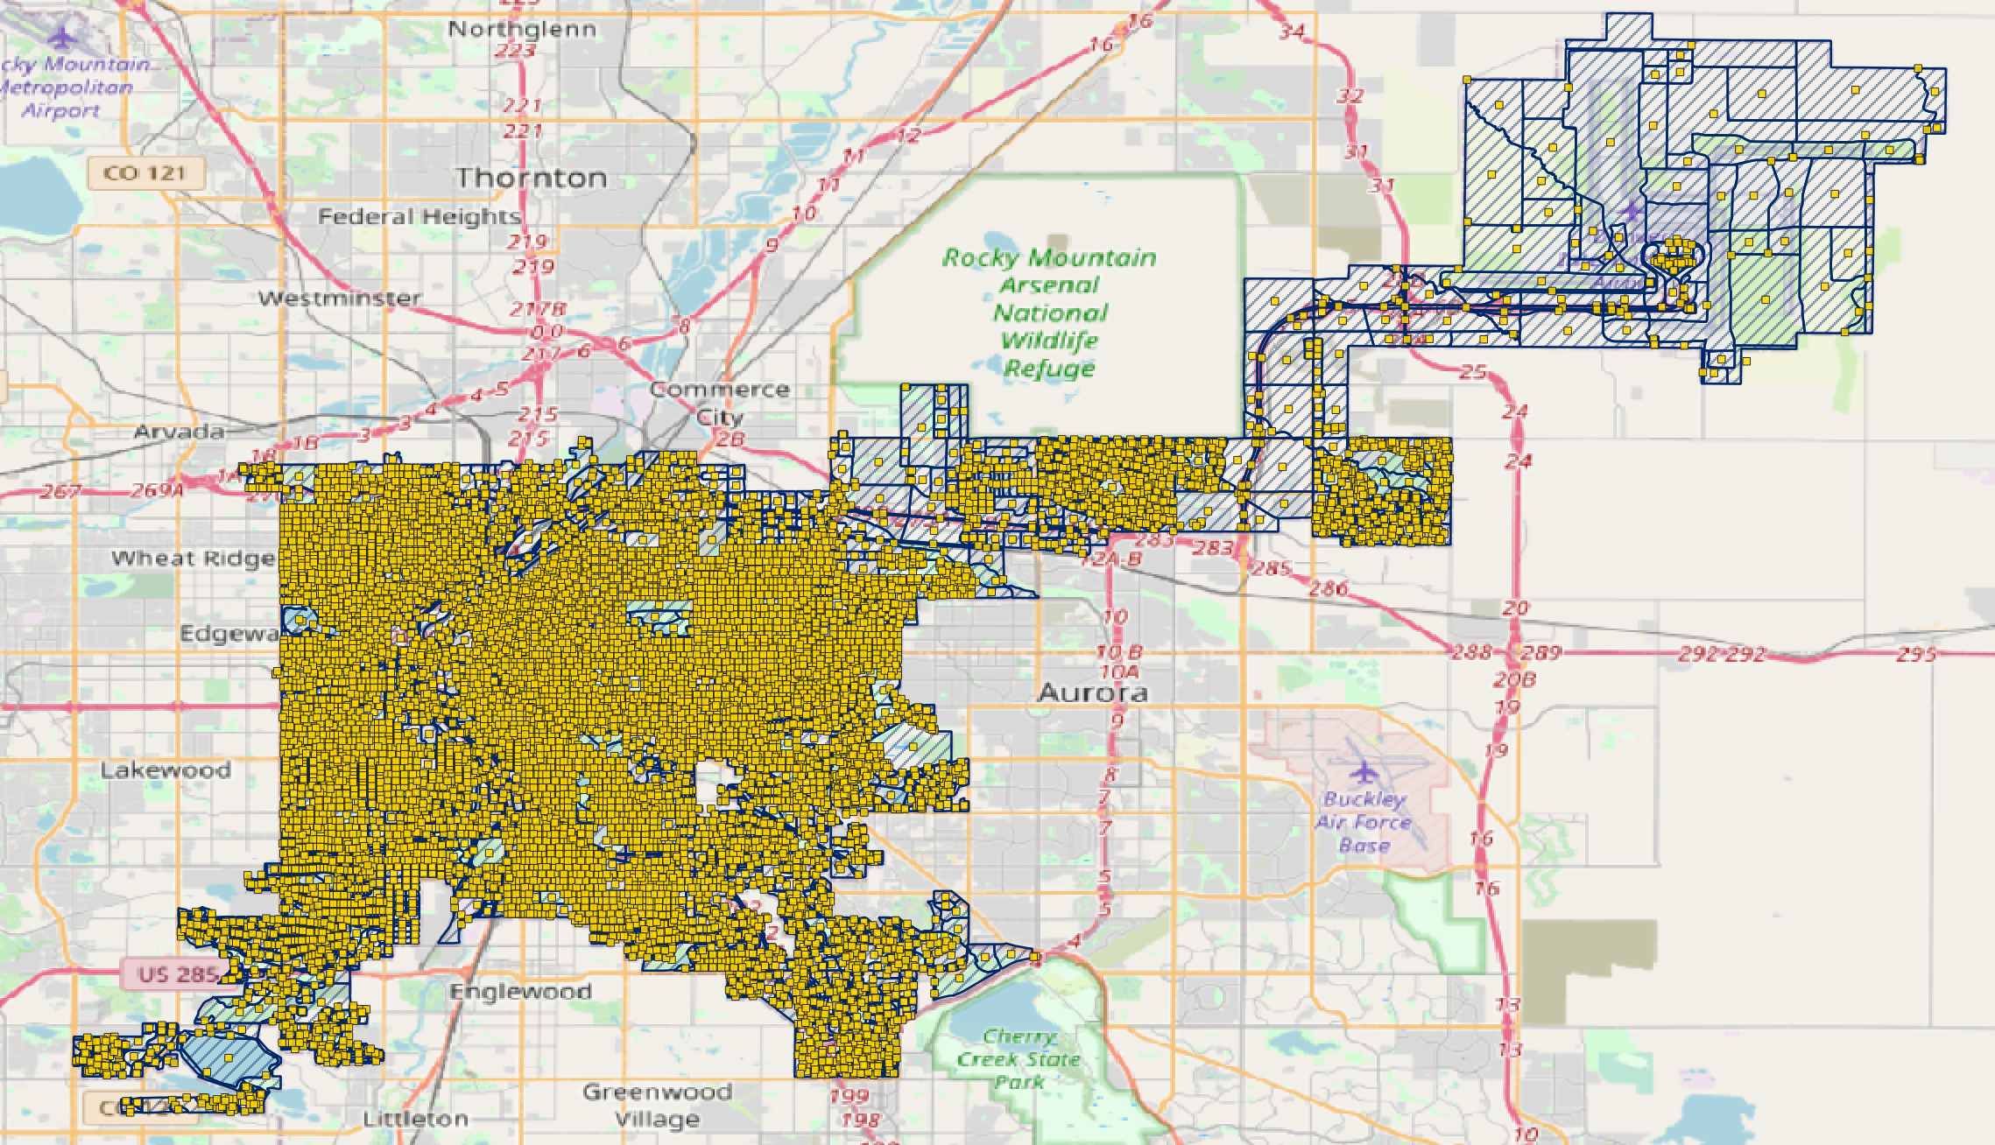
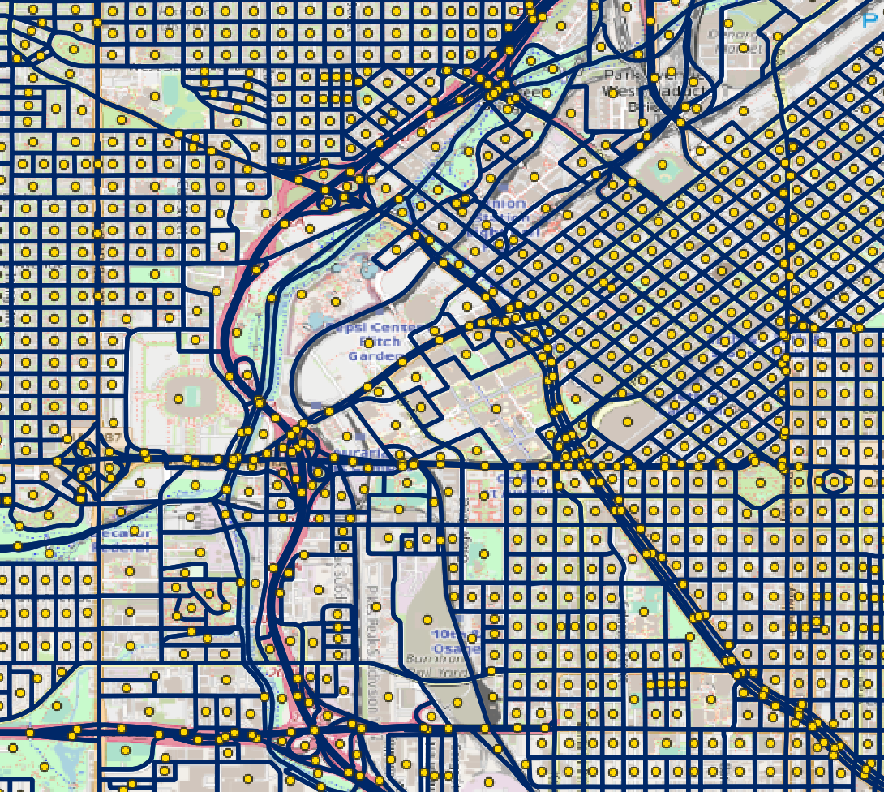
The Centroids of Census Blocks
-used data from Denver County website
-used QGIS to visualize census blocks and compute centroids of blocks
-exported centroids in lat/lon to use in our program
Zoomed in view near campus!
Notes:
-11,039 total census blocks
-Centroid: the centroid or geometric center of a plane figure is the arithmetic mean position of all the points in the figure. Informally, it is the point at which a cutout of the shape could be perfectly balanced on the tip of a pin.
-can be outside the shape depending on how wonky the shape is

Slide 7
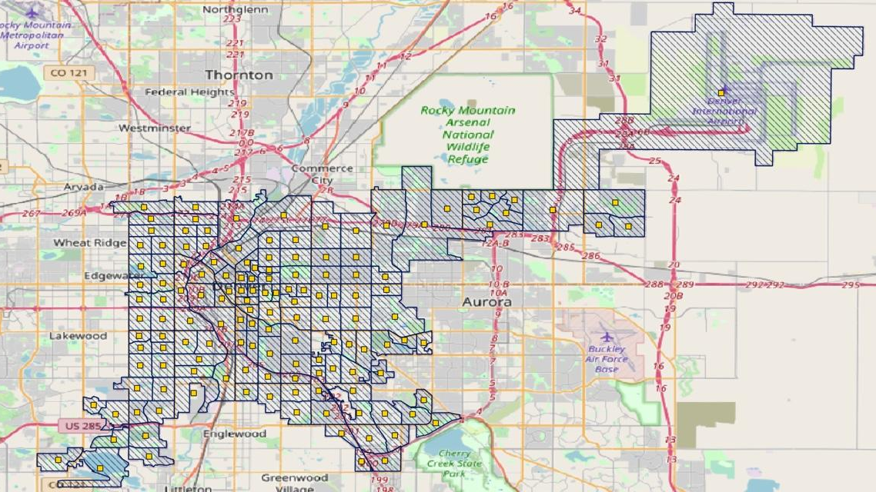
The Centroids of Census Tracts
144 total tracts
Notes:
-144 total census tracts

Slide 8
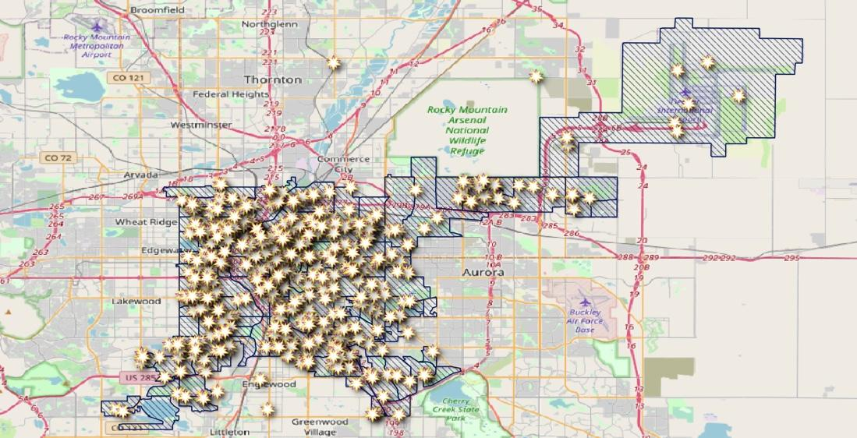
Potential Polling Locations
Churches
Fire Stations
Universities
Senior Living Facilities
Stadiums
Libraries
Recreation Centers
Notes:
512 total
-Churches: 300+ churches in Denver county, we used churchfinder.com to find the name and address of them all and manually inputted into spreadsheet
-Fire Stations: Sandy and Hope were nice enough to share their data with us for this! Thanks ladies!
-Senior Living Facilities/Stadiums: Had to google and input manually
-Libraries/Rec Centers: A nice list was available on the Denver county website, manually entered addresses/names into spreadsheet
-K-12 schools: States and municipalities are trending away from using K-12 schools due to danger to students, so we opted out of using these in our project! (There was a nice list on the denver website though)

Slide 9
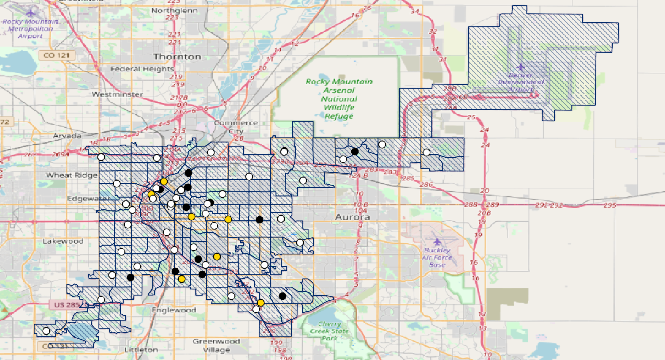
Current Polling Locations
Hand to person
Ballot drop off
In Person
Notes:
-19 hand to person --this is like the one at Tivoli
-38 ballot drop off boxes
-41 polling locations
-NOTE: some can double as both a drop off location and a hand to person location and in person.
-got this data from Diane Fritz, who got it from the Denver County website

Slide 10
The Program
An Assignment Model

Slide 11
What does the program do?
Assignment Problem: Given census tracts and possible polling locations, assign each tract to a location in some optimum way.
Coverage formula for the voting rights act.

Slide 12
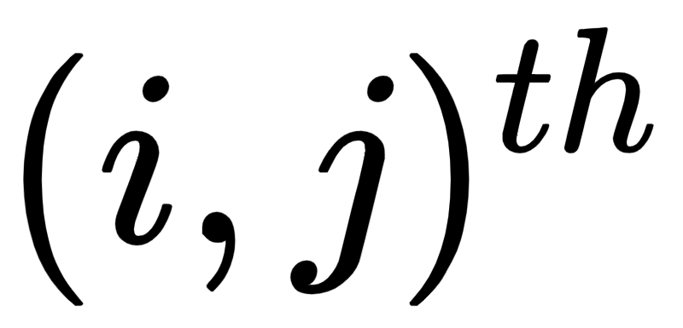
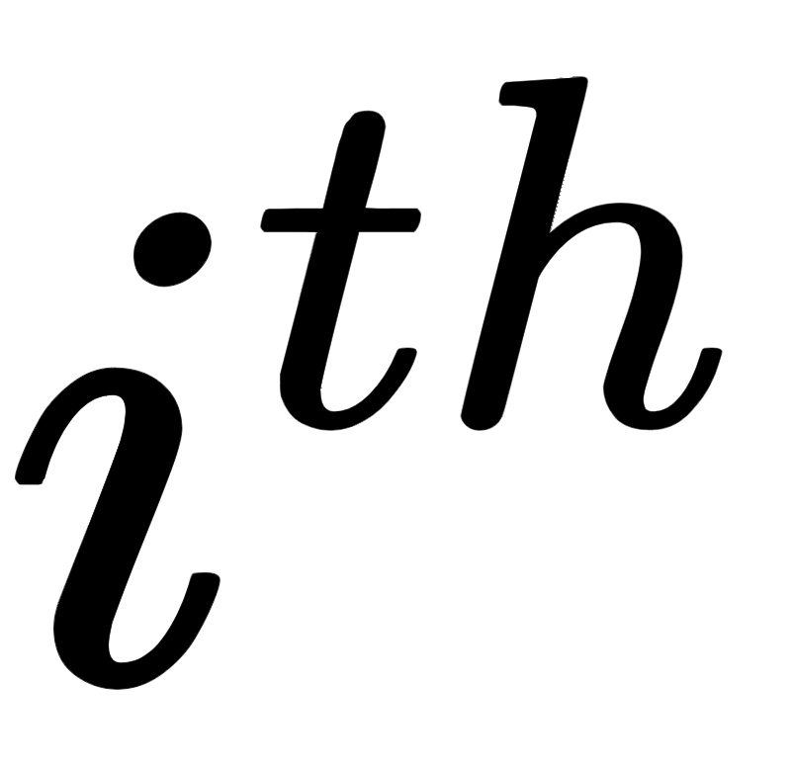
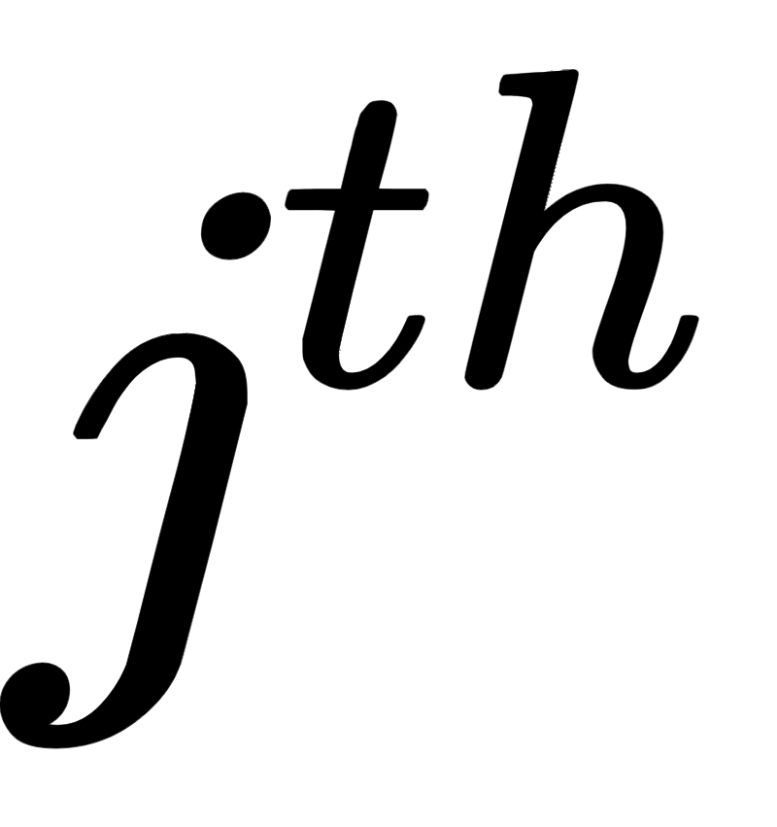
The Variables
Binary Matrix, loc_used (location used)
515 rows for 515 possible polling locations
144 columns for 144 census tracts
The entry is 1 if the tract is assigned to the location and 0 otherwise.

Slide 13
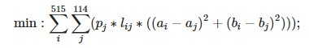
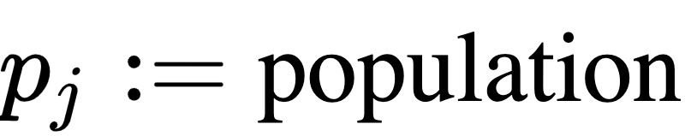
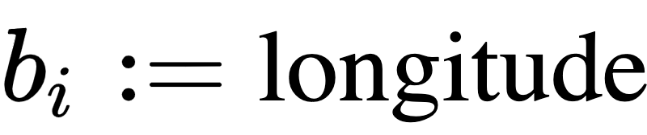
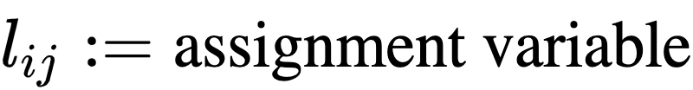
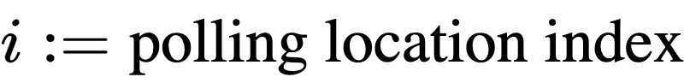
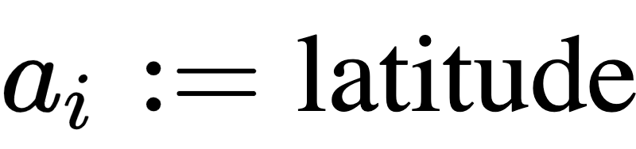
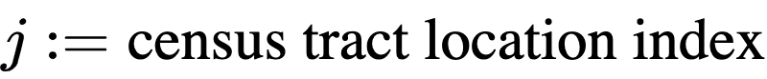
Objective Function:
Sneak peak of the code!

Slide 14
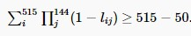
Constraints:
Assignment: Each tract gets assigned to a polling location
Max people at a polling location: Each location can handle up to 15,000 voters. We have 600,000 voters in Denver over 50 polling locations. There will be an average of 12,000 voters per location and we set the max at 25% more than the average.
Max amount of polling locations: There is an upper bound of 50 (approximately the number of actual locations in Denver) locations our program can use. An unused location corresponds to a row of all zeros in our matrix. This will count the number of such rows and ensure they count high enough so that only 50 places are used.

Slide 15
Results

Slide 16
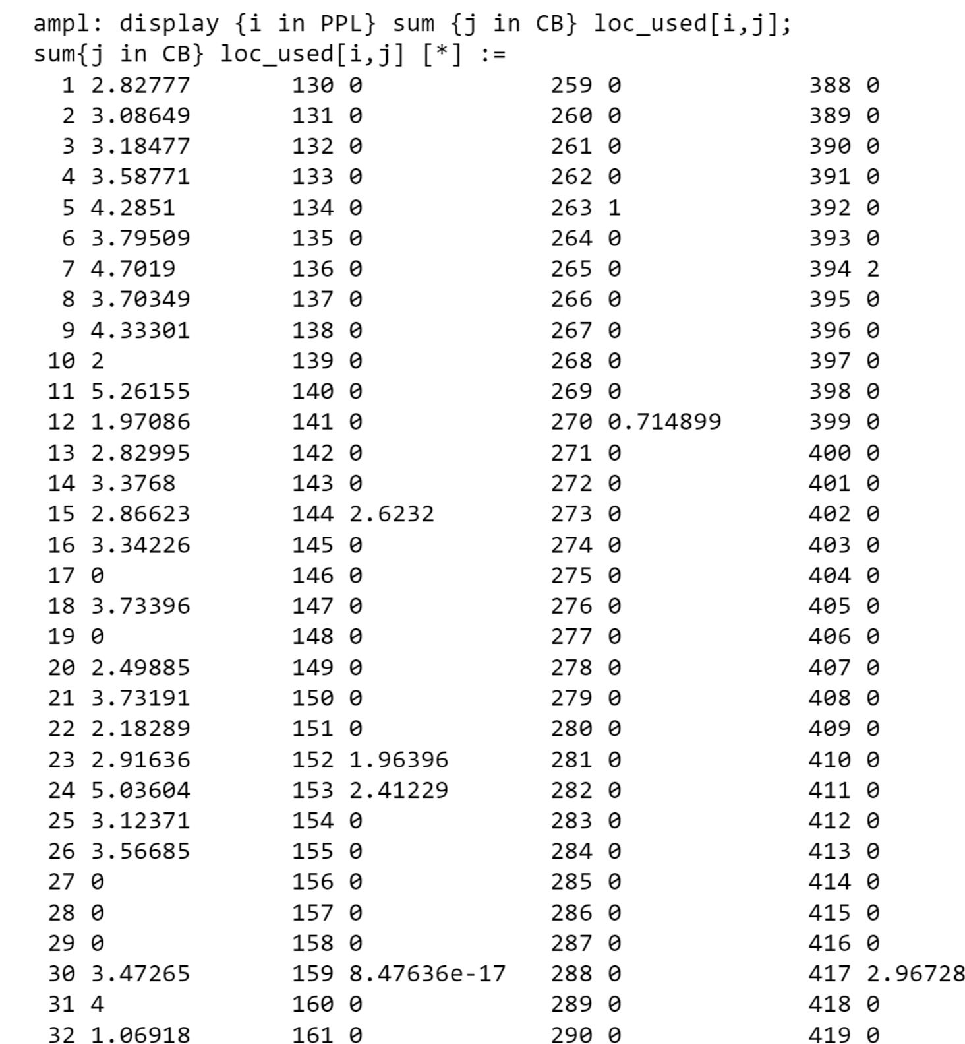
Partial AMPL output!
Notes:
144 Census tracts assigned to 515 polling locations

Slide 17
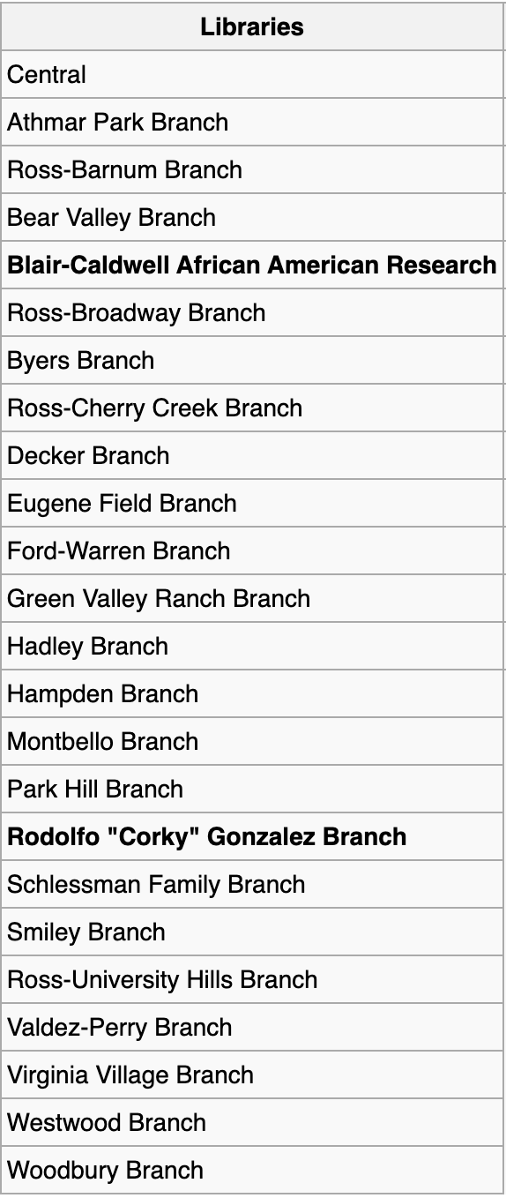
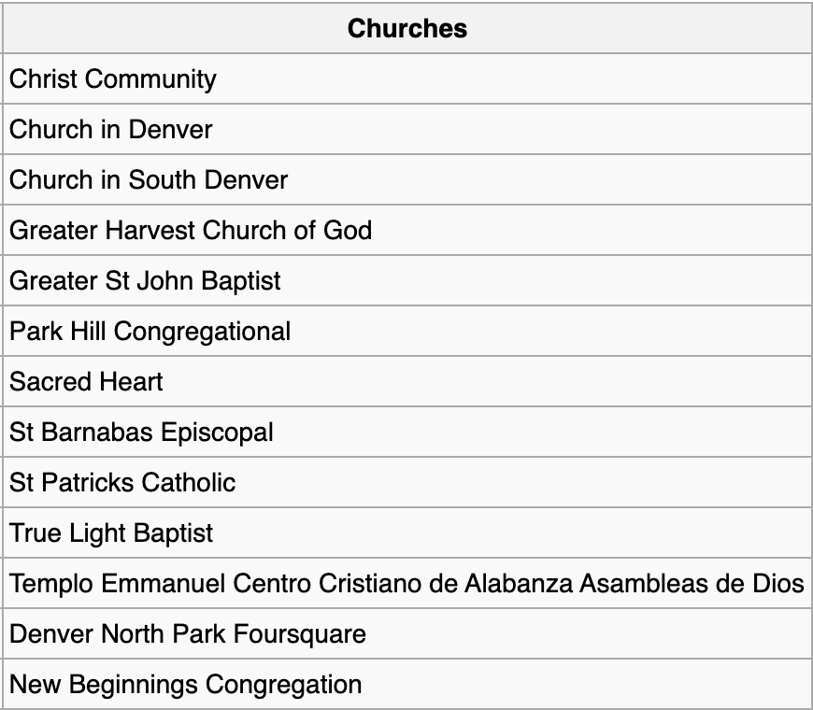
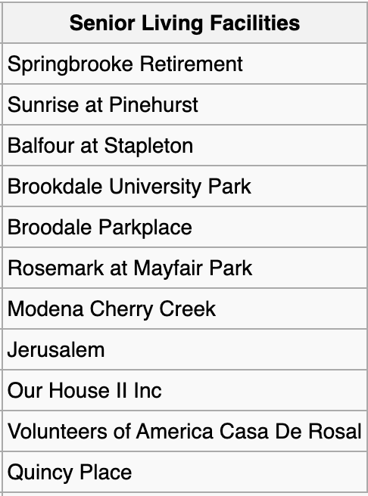
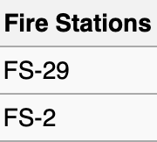
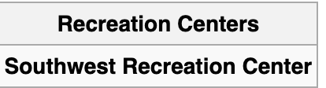
Optimal Polling Locations
Notes:
Locations of our optimal solutions
We speculate , Might be more optimal solutions ; Smallest indices

Slide 18
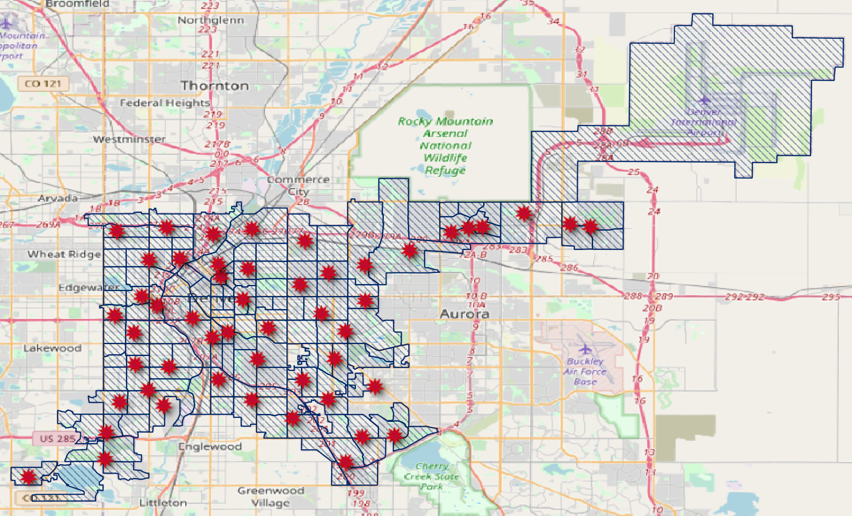
Optimal Polling Locations
Optimal Polling Locations
Notes:
Nice distribution

Slide 19
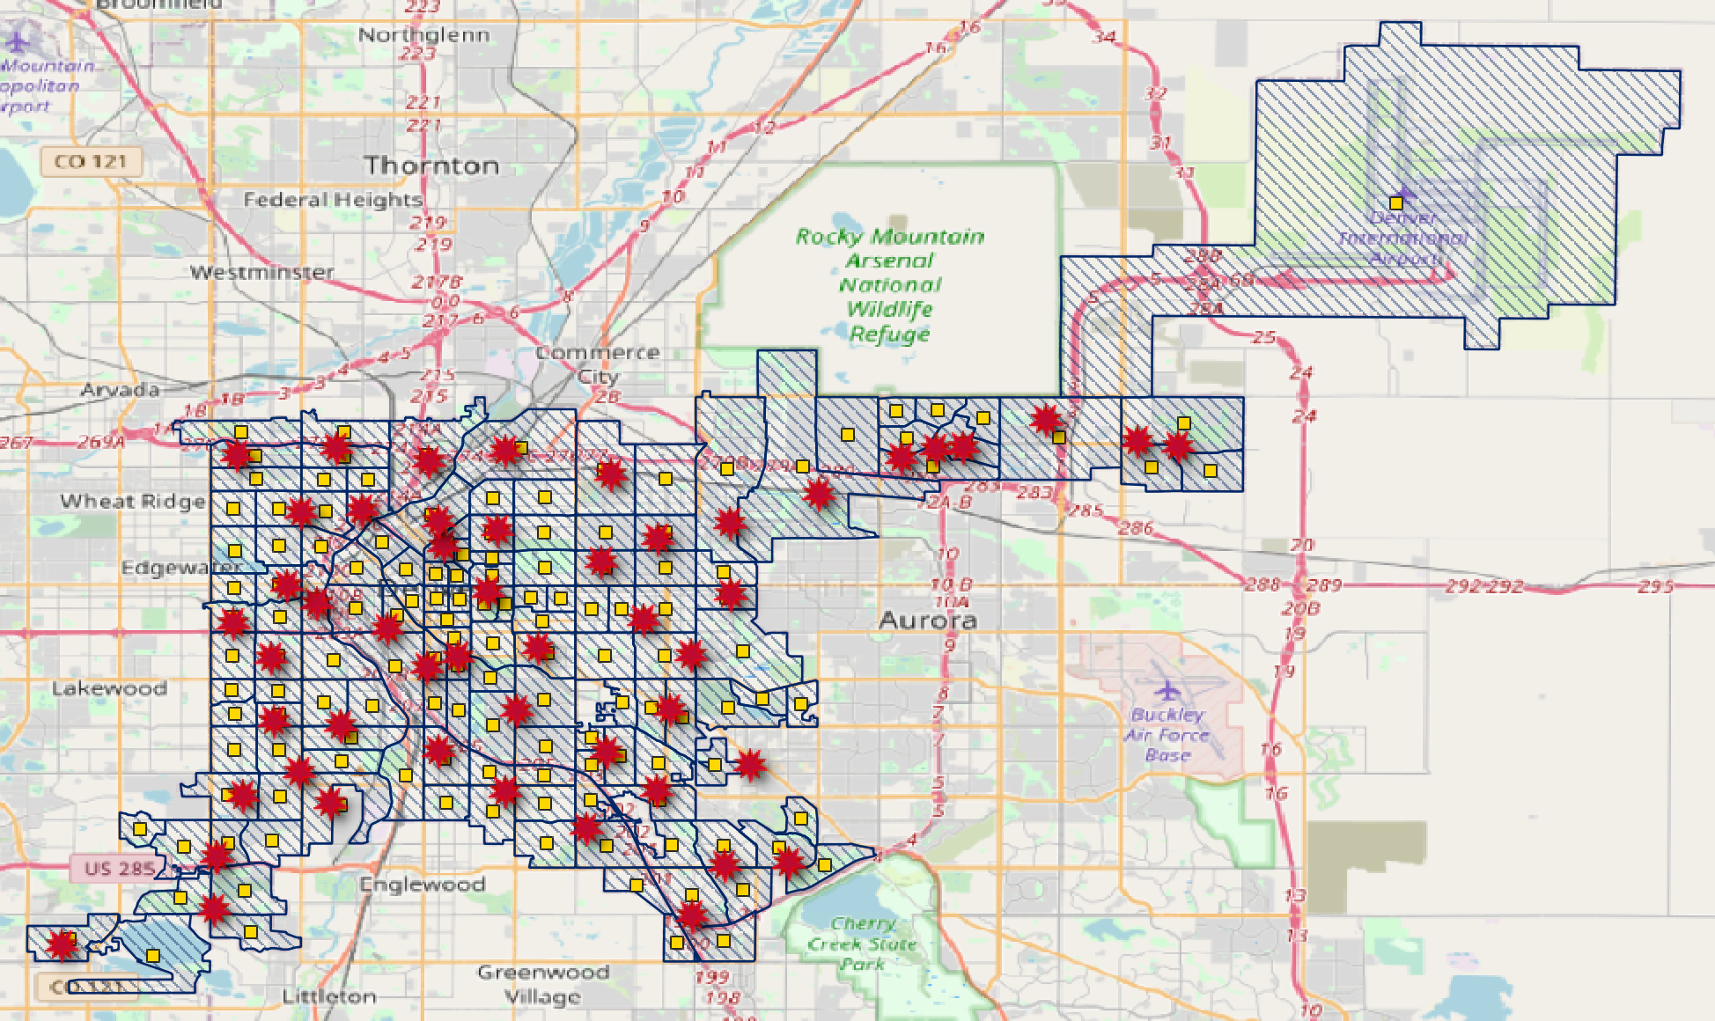
Optimal polling locations compared to
Census tract centroids
Optimal Polling Locations
Centroid of Census tract

Slide 20
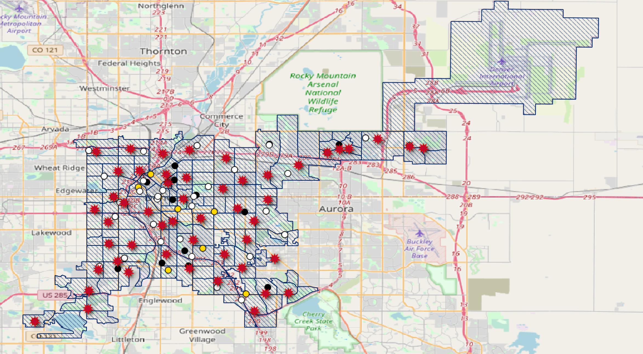
Optimal vs Current
Optimal locations
Current in person
Ballot drop off
Hand to person
Notes:
Some optimal are in close proximity to current
Blair caldwell - downtown denver
Rodolfo corky gonzalez - left of downtown
Southwest recreation - left most point

Slide 21
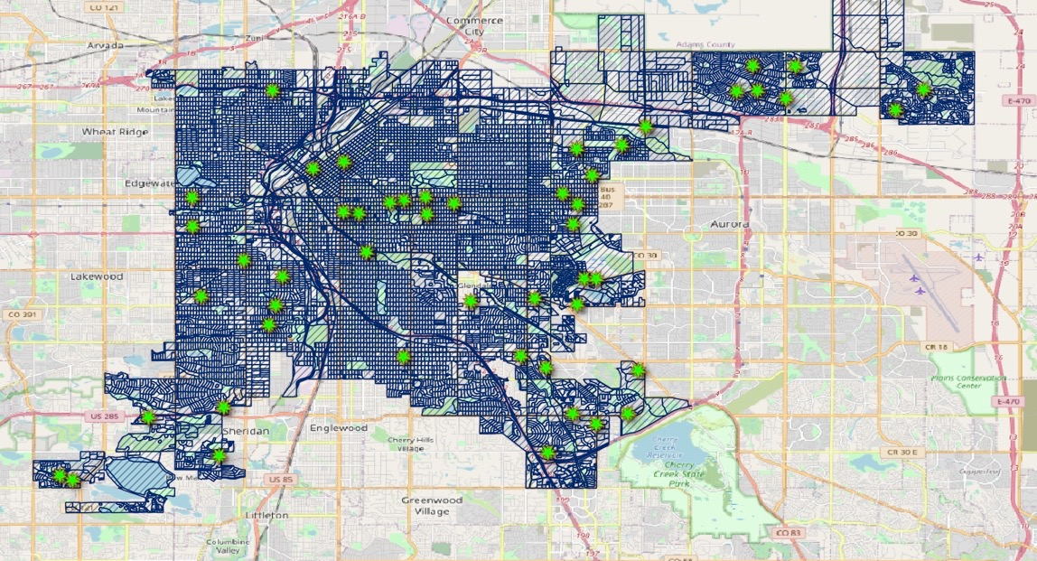
Issues/Problems with our model
-With census blocks over 5 million variables
-Can’t run an integer program with that many variables
-Adjusted program to run with 5 mil variables, but required some manual adjustments
The optimal locations with our adjusted program
Notes:
11,037 Census blocks (over 5 mil var); 144 Census tracts (50,000 var)
Our original program used all 512 of the polling locations, or almost all of them, and assigned census blocks based on minimizing distance.
Troubleshoot: Our adjusted program took the 50 polling locations with the most assigned people, and then re assigned the census blocks whose location we got rid of to one of the 50 remaining. We felt this was a less than optimal distribution. Felt like we could do better.

Slide 22
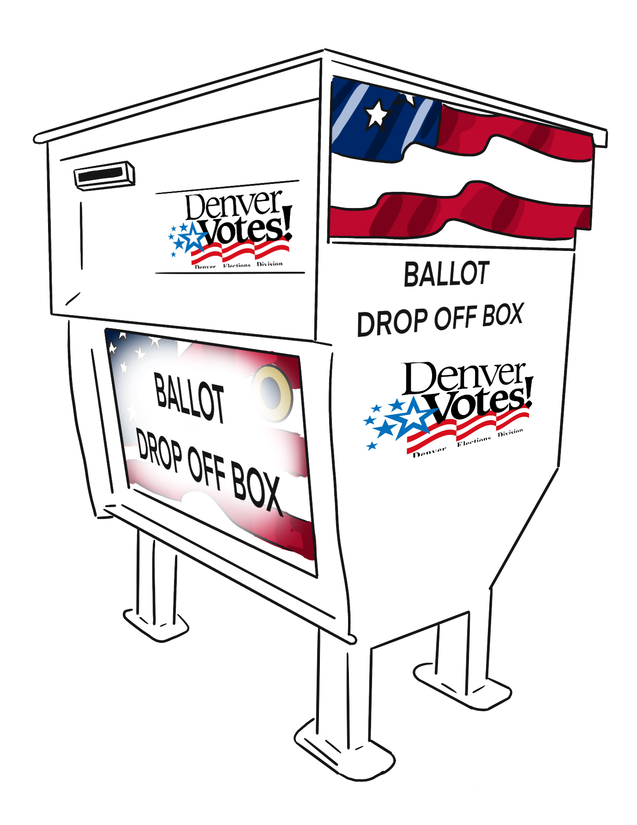
Quick recap of Future plans
Gather data from other states with more historical voter suppression issues
Georgia, Texas, Arizona, etc.
Take into account location to bus stops/train
Gather information on capacity of polling locations
Get information on resources for polling locations
How many volunteers
How many voting machines
Expand to include drop boxes and mobile voting stations
Notes:
Better # total people in polling locations can be better than our guestimate of 15000

Slide 23
QUestions?

